Slide 1

Е-coin is an exclusive currency you can trust

Slide 2


Bitcoin is an open-source cryptocurrency
No control: bitcoin don't' depend on any financial institution
Real currency: cash online
Constant growth: price for 1 BTC is growing steadily (in 2016 grew by 123%)
Network: connected computer network with installed equipment for mining and bitcoin control
Inflation: bitcoin is not subject to any fluctuations in the financial market

Slide 3
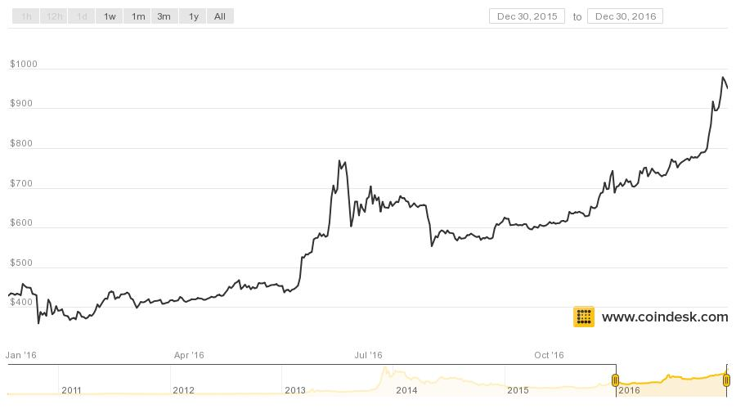
Bitcoin market

Slide 4
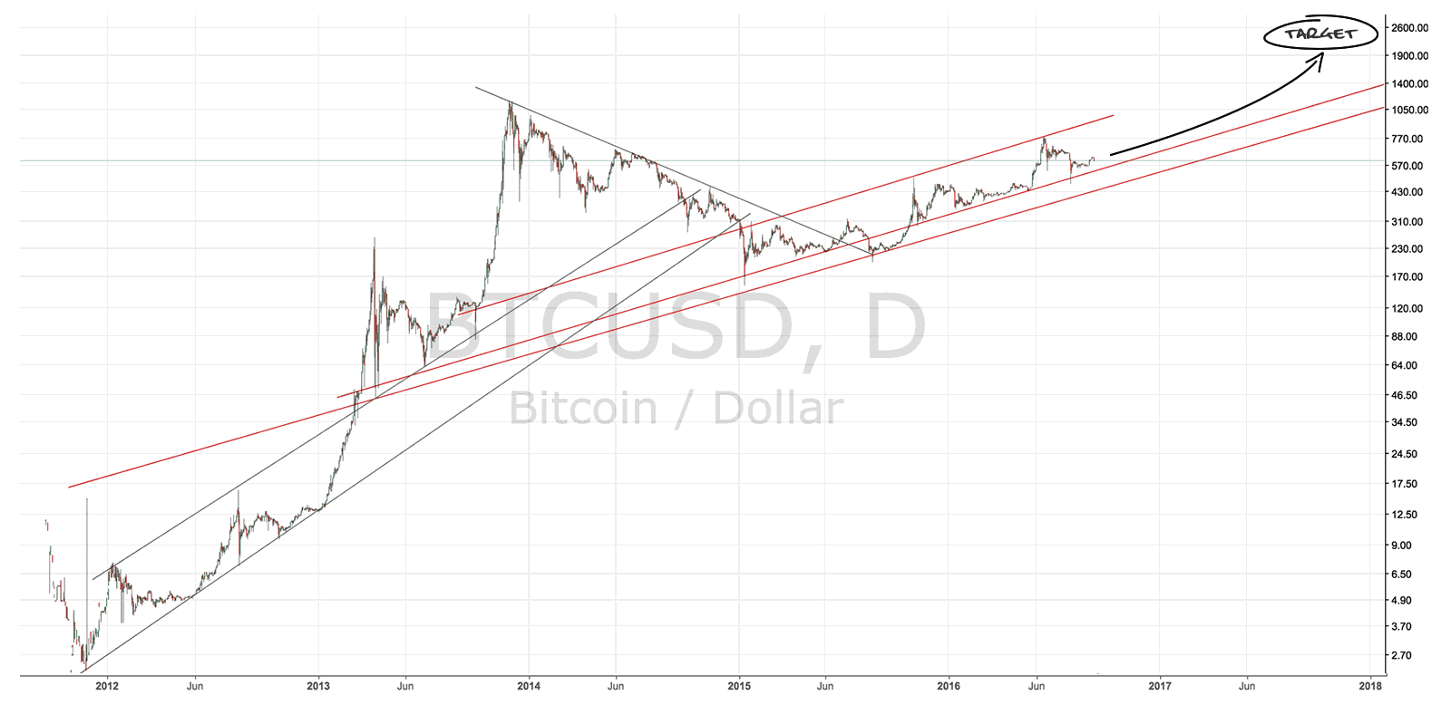
Bitcoin price forecast for 2017
*as of December 2016

Slide 5

Market forecasts for 2017
Real currency: 2017 year will be the year when people start to use bitcoin as well as enjoy with fiat currency
Growth: range from $2000 to $3000 (in December), throughout the year will overcome the mark $3000 and the price strengthens above $2000
Progress: the adoption of technology by large companies, price stability, a further influx of capital and increased investor confidence
Scaling: solution to scaling problem due to Segregated Witness, or "SegWit", increase of network bandwidth
New currencies: new digital currencies will be very popular, their price will rise quickly

Slide 6

Why us?
Our team will be able to create new cryptocurrency (the name is optional)
Our software that allows to mine bitcoin by 50% more efficient than the existing algorithm
We developed a technology enabling engines to produce electricity on the principle of magnetic induction. This allows saving money to build mining stations
Our development will reduce the cost of cryptocurrencies mining by 80% and create a currency that will be more profitable than existing cryptocurrencies

Slide 7
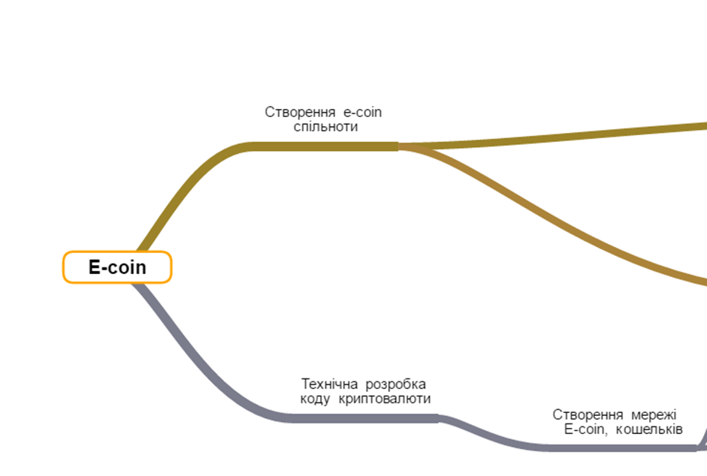
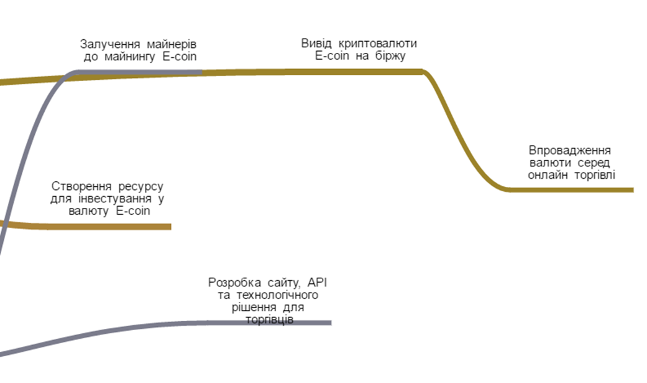

Diagram of e-coin development process
Bring cryptocurrency on currency exchange
Attraction of miners to E-coin
E-coin network development
Bring cryptocurrency on online trading
Create platform for investments in E-coin
Website development. API and technology solution for traders
Technical development of cryptocurrency code
Create E-coin network and wallets

Slide 8

Equipment
To implement "E-coin" business idea it is needed to buy equipment for mining cryptocurrency, service processing, place and configure it in server room

Slide 9

Technical characteristics of the server room
• Size. The server room should be at least 14m²
• Location. The premises for the server room should not have exterior walls of the building. For fault-tolerance purposes equipment, it may not be located in the basement or lower of flood waters, and on the upper floors of the building, as they are more likely to suffer in the fire.

Slide 10

Layout of the walls, floor and ceiling. The walls must be sealed, fireproof (at least 45 minutes); floor decks should be waterproofed. Width of the doors: not less than 910 mm, height – 2000 mm, doors should open outwards through 180°.
Server room should be without windows. It is recommended to use slip floor (raised floor), the distance from floor is more then 400 mm. The material from which it is made must be durable, abrasion-proof and have an electrical resistance to ground of 1 to 20 Ohm. For rapid drainage in case of flooding of the space under the raised floor, install the drainage system.
In the machine room shall be provided a ramp with a slope not more than 1:10 for the safe import and export of equipment.
Technical characteristics of the server room
10

Slide 11

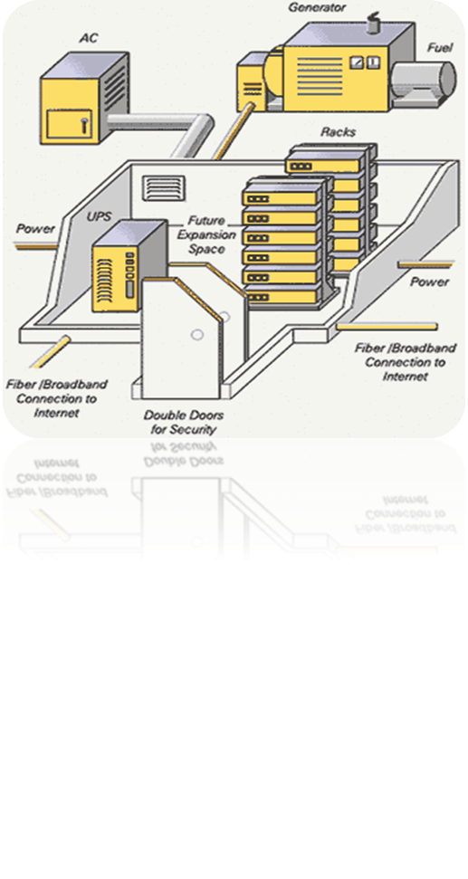

Climate control systems
In a server room may not be used for highways and utility systems of general use. This does not apply to systems necessary to equip the control room itself.
To maintain the temperature in the range of 18 to 24 °C and relative humidity from 30 to 55% it requires the installation of air-conditioning system, which consists of at least two independent air conditioning: each must provide the required temperature conditions.
The power conditioner must exceed the total heat dissipation of all equipment and systems located in the server.
11

Slide 12
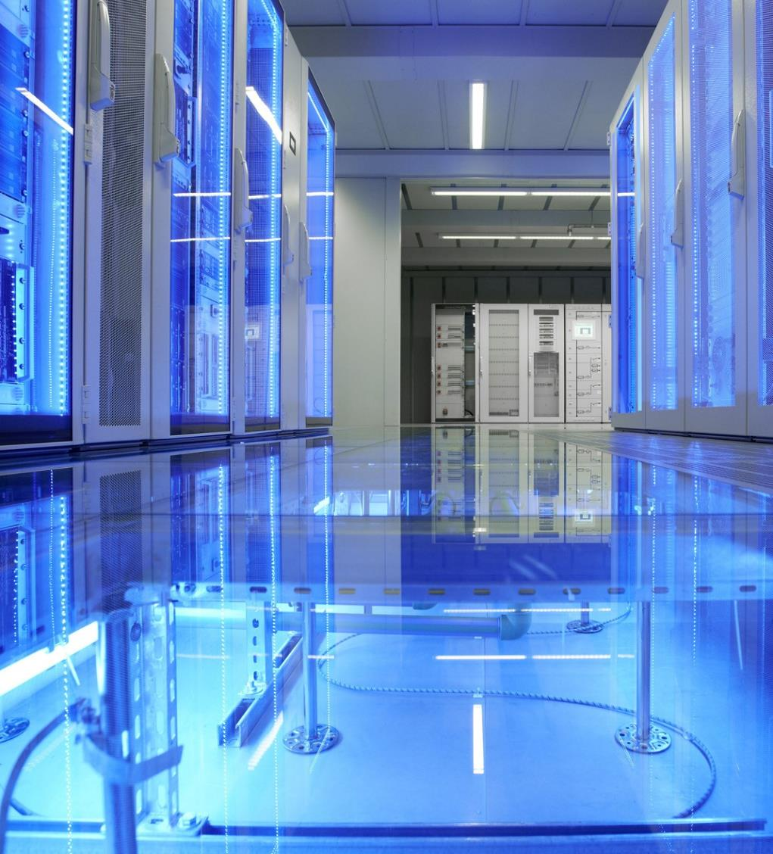
Climate control systems
The ventilation system maintains indoor excessive pressure – volume of incoming air must be 20% more than the amount allotted. The power system should provide (at least once per hour) a complete change of air.
The duct supply and extract ventilation provides the safety valve, controlled by automatic gas extinguishing systems.
Conditioning systems and ventilation systems must shut down on fire alarm signal.

Slide 13

Power of the server room
Electricity: 10-15 kW/h
Internet: 1GB/sec (2x)
Generator: if the power supply is not stable, that is, when the possible lack of electricity is more than 30 minutes (if the building has no generator), it is recommended to use the generator type LPG FORTE FG-6500E or better.

Slide 14

Technical specifications of server hardware
For cryptocurrency mining it is requested to purchase equipment (4 pieces) on the basis of the Radeon R9 390 or above

Slide 15

Equipment for cryptocurrency mining
Server hardware for routing and processing services.
Dual-processor server XEON E5-2600 on 16 cores (8*2.6 GHz), Raid 512 MB, 4*4000GB IntelliPower AV-GP, min 64GB ECC RDIMM, 1U or 2U formats
Core i7-6700K 4*4 (8 cores) 16 GB RAM 120 GB SSDб, 1U or 2U formats
Workstation to control the servers, may use the mono block on the basis of Windows 10, 4U
Server rack, table
Uninterruptible power supply, which consists of 7 UPS FSP VEST-650 and one UPS FSP KNIGHT PRO 1000VA (ON-LINE)

Slide 16

Software
Development

Slide 17


Implementation of cryptocurrency code
To implement of "E-coin" it is necessary to develop a code for cryptocurrency and organize the primary network for its operation.
Based on the blockchain we can take the Crypto 2.0 technology or other relevant.
Also it needs to be developed:
• Program for wallets for desktop and mobile use
• Online service (API) for quick access
• Service for traders
• Investment platform

Slide 18

Implementation of cryptocurrency code
E-coin should retain the main features of the cryptocurrency, and also to add new functionality, which would most accurately meet the needs of the market.
Cryptocurrency must be quick, limited issue and safe. To develop a proposed cryptocurrency based on sha-2 hash.

Slide 19

Wallets, API, services for traders
These services will make use of a currency as convenient and simple, which is very important for the investment attractiveness.
Among the basic functionality of such services is the ability to implement transactions, monitor them, to connect via API to automate the translation. And the system that crypto-marcenat, which would simplify the exchange sites for traders.

Slide 20
The idea of the investment platform
Investment platform is a unique website where anyone can invest in the mining (equipment) for mining cryptocurrency, and buy cryptocurrency.

Slide 21

Our Contacts
Ukraine, 04053, Kyiv
1-5 Artema Str., office 706
info@supportua.org.ua
http://itukraine.org
+38098 717 77 17

